Slide 1
Cloud Deployment Models
Week 11th
CE-408
Safia Baloch

Slide 2
Choosing right deployment model for your organization
Technical requirement, operational preference, cost consideration
Technology Fit
Operational Fit
Cost

Slide 3
Model Based Deployment
Deployment Model: how resources of a system are employed to execute the application function.
Beyond the capabilities of the resources, it is deployment that essentially determines the runtime properties of the system , e.g.
Responsiveness, reliability, availability.
The automatic, or machine supported design of a deployment.
What is Deployment? “Central resource broker”

Slide 4
Private Cloud
Referred as “internal cloud”, Traditional IT environment
Incorporates cloud characteristics , if designed with virtualization and orchestration tools
Benefits of Private Cloud:
Complete control over entire stack
Enhanced security to keep sensitive data in-house
Customization of infrastructure to meet specific business needs.
On demand data availability

Slide 5
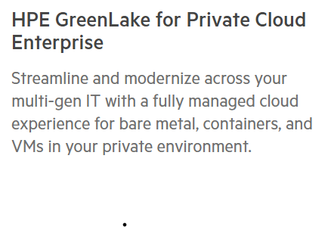
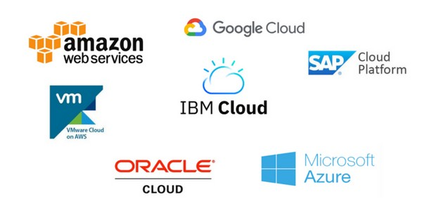
Vendors of Private Cloud
Private cloud stacks:
Vmware
Microsoft
RedHat: subsidiary of Ibm:
Dell EMC: PowerFlex
OpenStack
HPE: Hewllet Packard Enterprise

Slide 6
Public Cloud
Referred as “Cloud Computing”
IT services on infrastructure provided by third party.
Operate on Multi tenant model ( multiple customers sharing same infrastructures)
Suitable for which type of business ?
Benefits of Public Cloud:
Cost Efficiency: Pay as you go
Scalability for resources up and down over demand
Accessibility from anywhere with an internet.

Slide 7
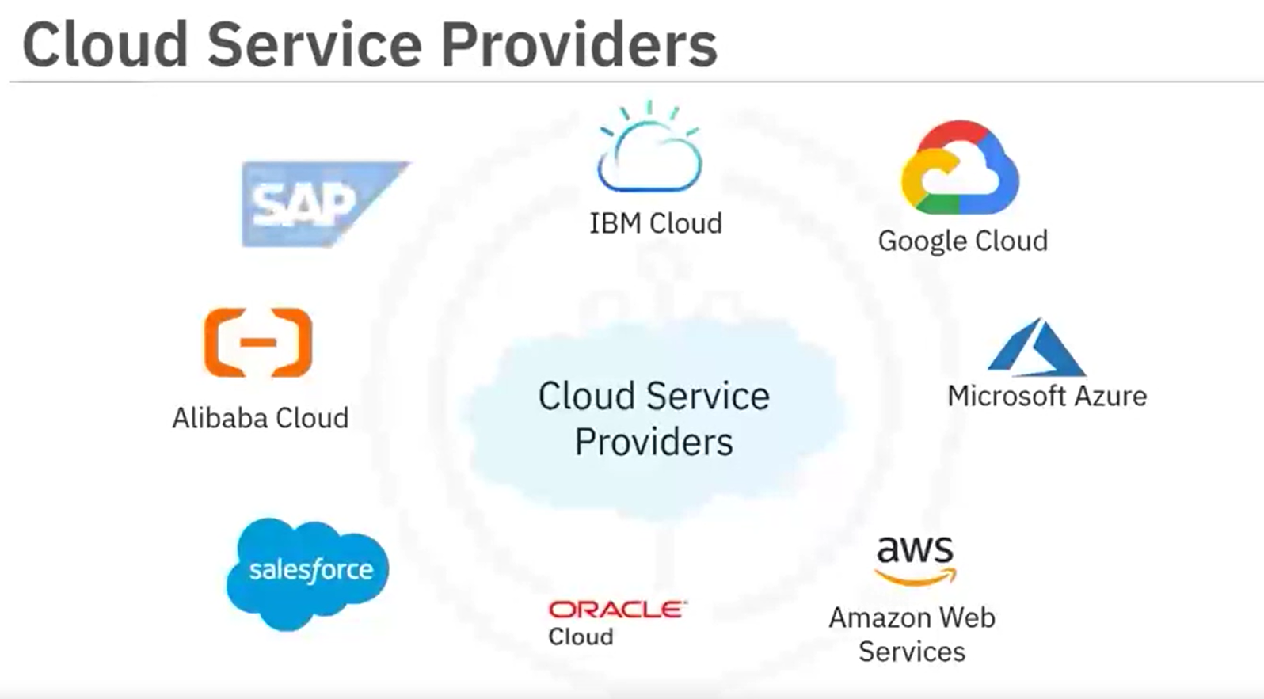
Vendors of Public Cloud
Amazon Web Services
Microsoft Azure
Google Cloud Platform

Slide 8
Hybrid Cloud
Combination of private and public clouds
Creating flexible and unified environment
Organization which requires balance between security, compliance, performance.
E.g. storing data in a private cloud for compliance reasons and using public cloud services to deploy customer facing applications globally.
Cloud Bursting ?
How can you implement cloud bursting on AWS?
When do organization use cloud bursting?
Marketing campaigns
Big Data analytics

Slide 9
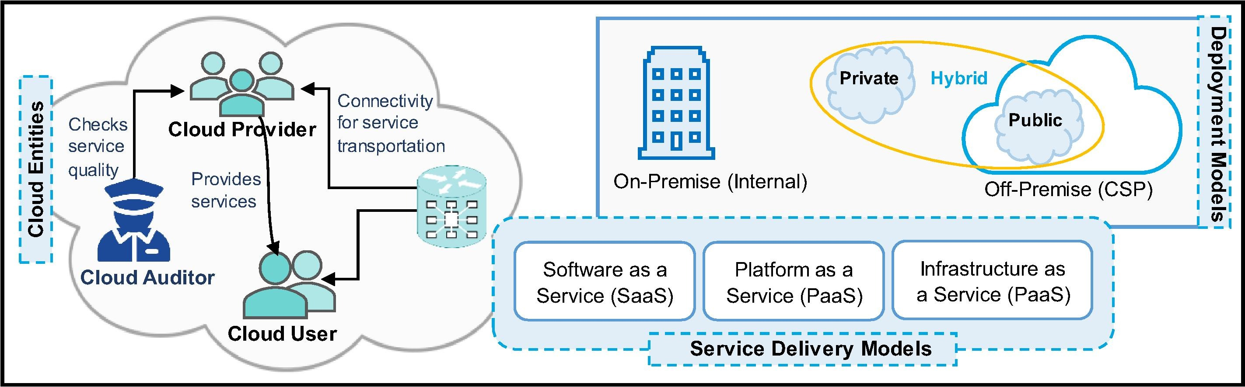
Benefits of Hybrid Cloud Flexibility between on premises, private, public cloud Scalability Compliance

Slide 10
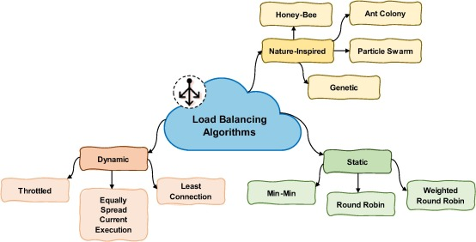

Slide 11
MultiCloud
Multiple cloud services from different providers simultaneously
E.g. an organization might use Microsoft Azure for certain workloads and AWS for others.
Complex to manage
Benefits of Multicloud:
Vendor Independence to reduce reliance on single cloud provider
Cost Optimization by choosing the best/suitable provider for each workload
Flexibility in operations and resilience

Slide 12
Ideal Deployment Model for following use cases( private or public)
Relieve demand on IT resources
Protect sensitive information, including intellectual property
Scale up quickly and accelerate time to market
Meet data sovereignty or compliance requirements
Run workloads over the short term
Ensure high availability
Manage upfront costs

